Slide 1
Develop a Deepfake scam call detection application for Samsung phones
EDABK Teams
School of Electrical and Electronic Engineering Hanoi University of Science and Technology

Slide 2
Introduction of Research Team
[Research team and their research background]

Slide 3
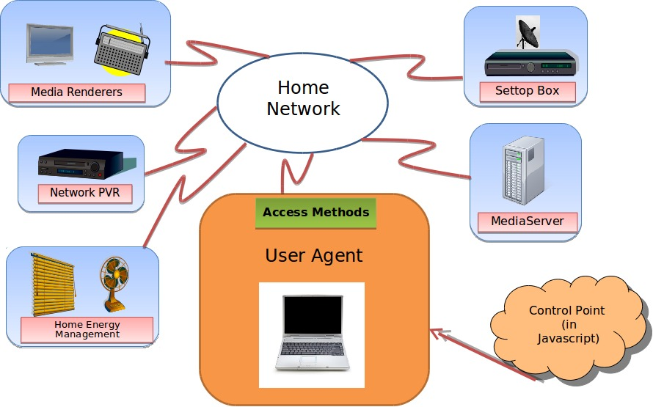
Idea Concept
[Describe here the concept of target product, using figures and diagram.]
Fig. 1. An example of system architecture

Slide 4
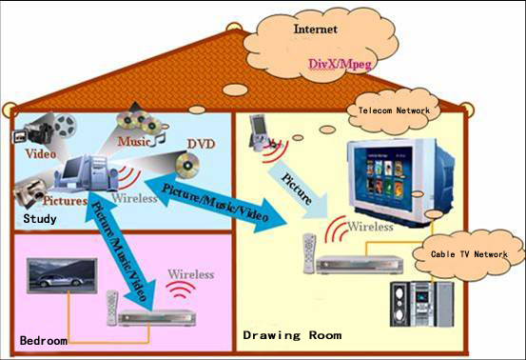
User Scenarios
[Describe here the key scenarios of target product, with emphasize on differentiation of your ideas]
Fig. 2. An example of system architecture

Slide 5
Competitiveness
[Describe current status of existing solutions and its technical approaches.
Then author should magnify differentiation of proposed approach to emphasize value of project.]

Slide 6
Current status of proposal
[Describe current status proposal: concept / analyzing feasibility / feasibility analyzed / working sample (prototype)]
[Details regarding your status above]

Slide 7
References
[Link to some work which are relevant to the proposed idea]
[List some highlight publications of the authors related to the proposed idea]

